Slide 1
WebAssembly
revolution that follows
Josip Klarić
Infobip

Slide 2
Agenda
What is WebAssembly and why we need it?
Current state
Demo
WebAssembly origins
Upcoming features
Use cases
Why revolution?

Slide 3
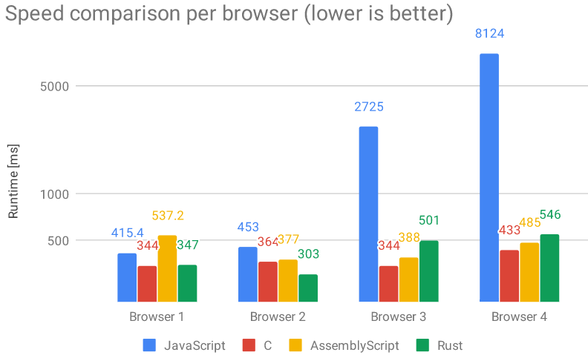
Why WebAssembly
Browsers are powerful
  Powered by JavaScript engine
Emerging technologies
  Virtual reality, machine learning…
  Heavy-weight category of software
Need for more processing power
Example:
  Rotate 4K image – 2 to 8 seconds

Slide 4
What is WebAssembly
Run non-JavaScript code in browsers
  No addons needed
Compact binary format
  Optimized for download
  Intermediate representation
  Compiled in browser for the specific machine
  Small overhead on top of machine assembly
Runs at near-native speed
Language and compilation target
Language for conceptual machine

Slide 5


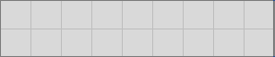
Isolation and benefits
Sandboxed by default
  Access to only dedicated memory set
  Comparable with virtual machine
  Isolated from the rest of the system
  Several levels of isolation
Benefits:
  Higher-level languages get speed
  Lower-level languages get isolation
  Strong type guarantees
  Consistent and reliable performance
Machine
Host (browser)
WebAssembly

Slide 6
Current state
MVP (v 1.0) released in 2017
  Still not widely used
  Just core functionality
  Supports C, C++ and Rust
In early stage
  Tooling in progress
  Supports only number types (integer and float)
All popular languages interested in supporting it
Lot more features are coming

Slide 7
DEMO

Slide 8
WebAssembly origins
JavaScript - interpreted and slow
V8 JavaScript engine released in 2008 (Chrome)
  Much faster execution using JIT compilation
Other browsers introduced their own compilers
Dynamic types affect the performance
  No consistency and reliability
function add(x, y) {
return x + y;
}

Slide 9

WebAssembly origins #2
Set of tricks to improve performance
  Asm.js
  Much better performance and consistency
Success of asm.js opened doors for new standard
WebAssembly was born
function add(x, y) {
x = x | 0;
y = y | 0;
return (x + y)|0;
}

Slide 10
WASI
Big feature with separate standard
Running WebAssembly out of browser
Communicate outside sandbox
Access host system resources
System calls like:
  Access file system
  Open network connection
  Access cryptography
  Use clock

Slide 11
Use cases
Port existing C and C++ code base
  Games (Quake, Diablo)
  AutoCAD, Lightroom
  Image codecs (WebP)
Shopify
  Allows customers to plug in their own specific logic
  Single worker handles over 1000 requests per second
Fastly
  Edge computing and CDN network
  Quick startup time under 60 micro sec
  New instance for each request

Slide 12
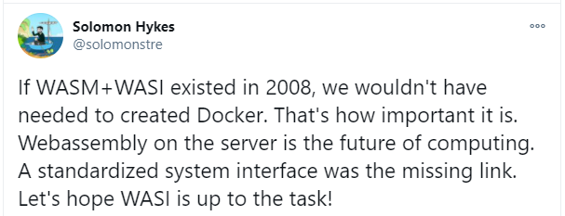
Why revolution?
Cross-platform format
Serverless scenarios
  No cold start problem
  Isolation
Developers united
  Single repository for all languages
Granular security
WASI

Slide 13
Thank you!

Slide 14
Questions?

